Slide 1
Age Categorization Program

Slide 2
Requirtement gathering & analysis
The program should ask for the name of user
The program should ask for the age of user
The program should detect the age group of user

Slide 3
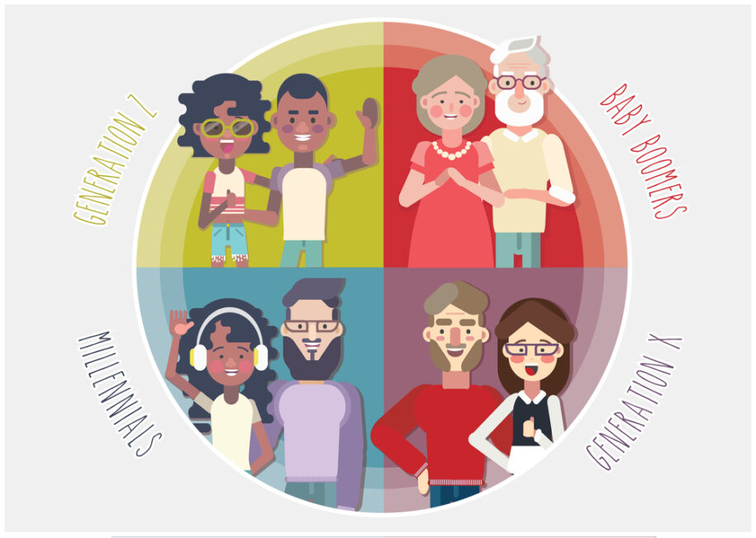
Design PHASE
System Architecture
A function for categorizing age using if
Using loop for asking next user’s name again using while

Slide 4
IMPLEMENtation & coding
Action:
(def detect_age(age) returning the age group)
Using while for multiple use

Slide 5
TESTING
Test Scenario | Input | Output
Child | 5 | Child
Adult | 23 | Adult
Senior | 67 | Senior
Negative input | -3 | Error Message
Not numeric | abc | Error Message

Slide 6
DEPLOYMENT & MAINTANANCE
The script should be downloaded and run on terminal
Age groups can be added in the future
Create GUI version using Tkinter

